Slide 1
Data Comics Creation Tool
Anežka Strnadová
Supervisors: Hana Pokojná, Katarína Furmanová

Slide 2
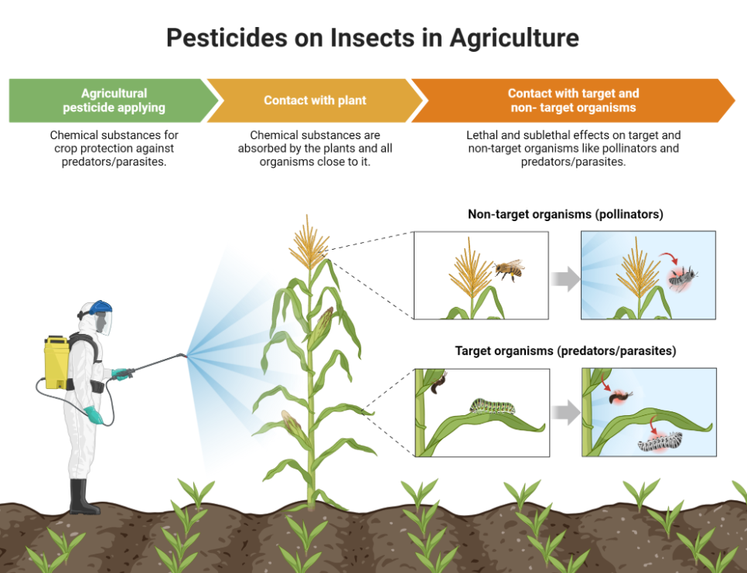
What is a data comic?
Comic version of academic manuscripts
Combination of images and short text
Easier to understand than research papers
Example of a data comic created in Biorender application

Slide 3
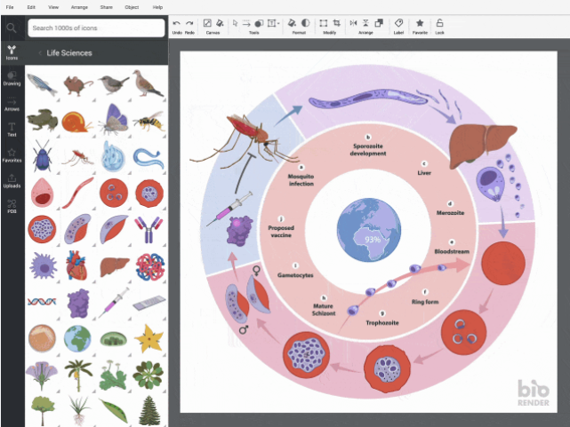
Existing tools
Biorender
Pixton
StoryboardThat

Slide 4
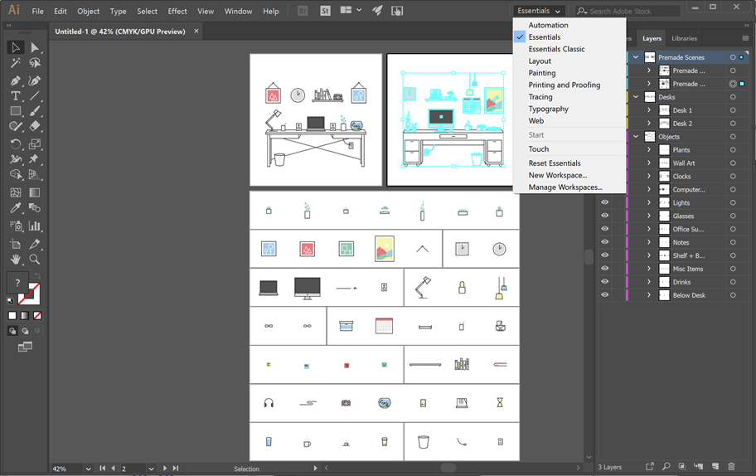
Easel.ly
Canva
Adobe Illustrator

Slide 5
What I have done so far
Designing the web page in Adobe Illustrator
Learning D3.js
Starting node.js server
Creating basic web application

Slide 6
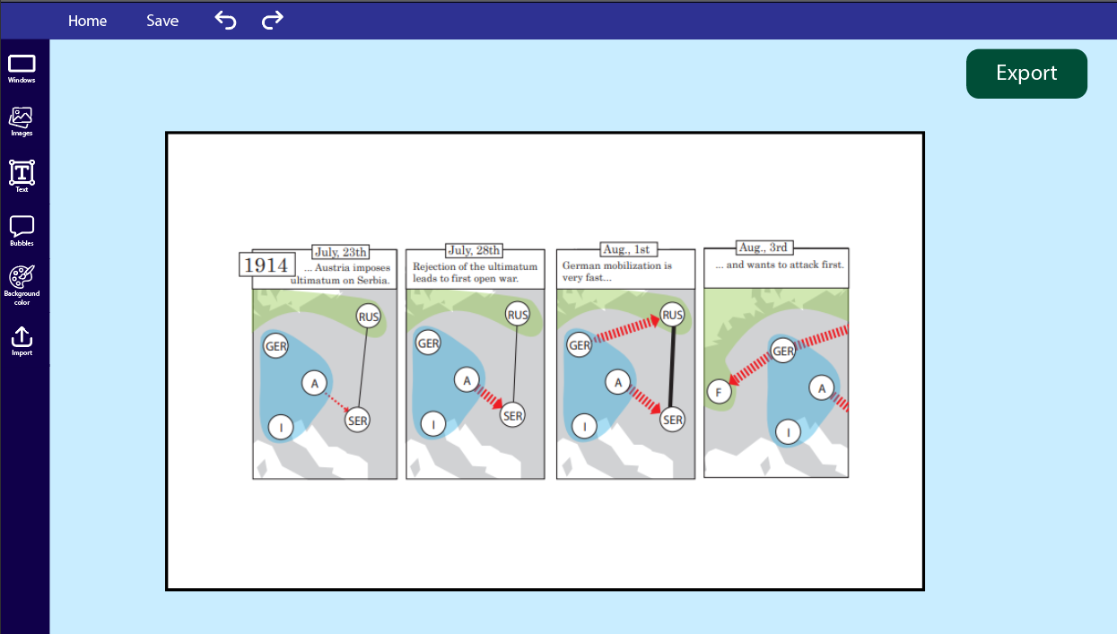

Slide 7
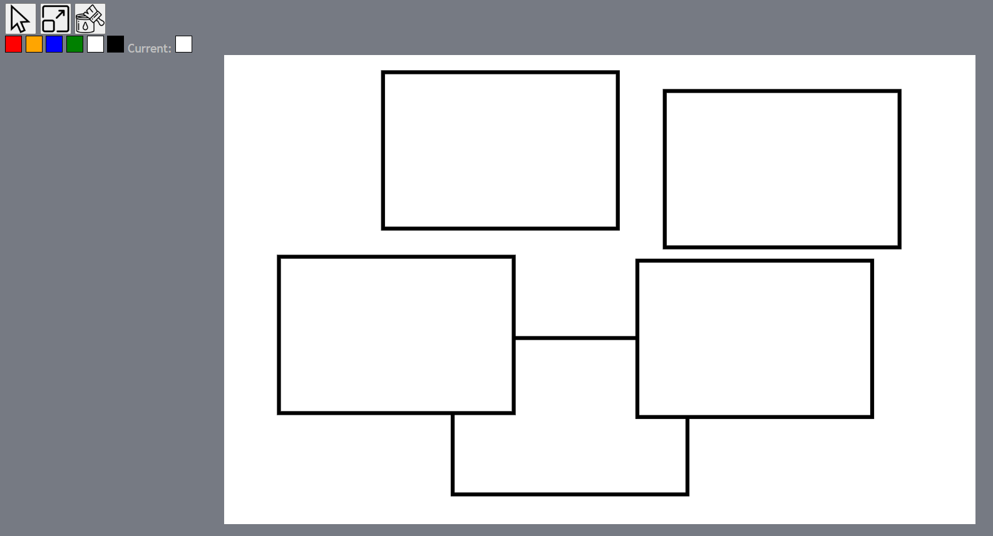

Slide 8
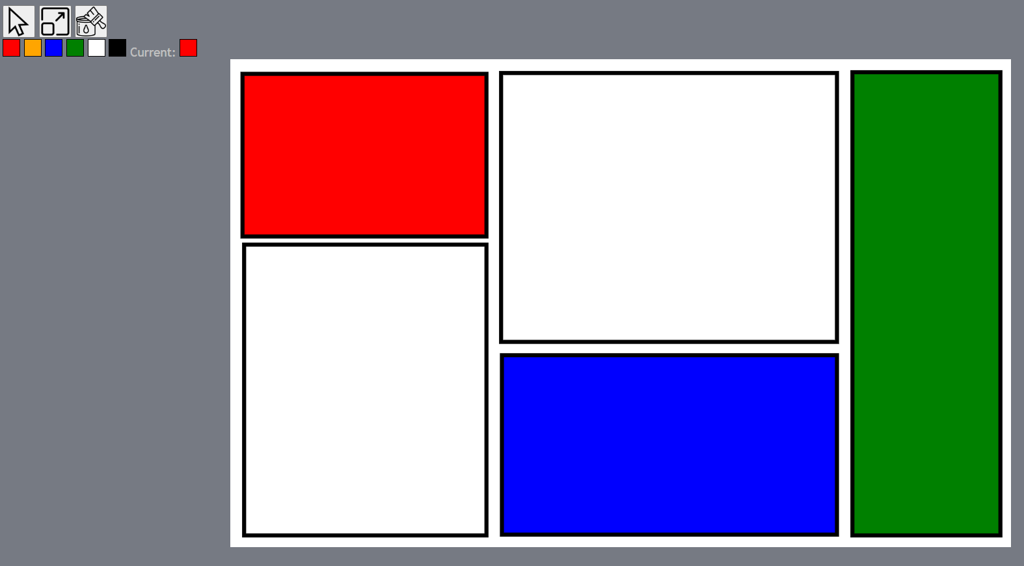

Slide 9

Future plans
Implementing more features:
Adding different shapes, text, more colors
Importing images
Exporting files
Improving design
Possible extension:
Connecting to AI tool that generates pictures based on text inputs

